Slide 1
SPAM DETECTION WITH MACHINE LEARNING
ABHISHEK-RA2011042010078
MANAVJEET –RA2011042010106

Slide 2
DETECTING SPAM
Detecting spam alerts in emails and messages is one of the main applications that every big tech company tries to improve for its customers. Apple’s official messaging app and Google’s Gmail are great examples of such applications where spam detection works well to protect users from spam alerts. So, if you are looking to build a spam detection system, this article is for you. In this article, I will walk you through the task of Spam Detection with Machine Learning using

Slide 3
SPAM DETECTION
Whenever you submit details about your email or contact number on any platform, it has become easy for those platforms to market their products by advertising them by sending emails or by sending messages directly to your contact number. This results in lots of spam alerts and notifications in your inbox. This is where the task of spam detection comes in.
Spam detection means detecting spam messages or emails by understanding text content so that you can only receive notifications about messages or emails that are very important to you. If spam messages are found, they are automatically transferred to a spam folder and you are never notified of such alerts. This helps to improve the user experience, as many spam alerts can bother many users.

Slide 4
SPAM DETECTION USING PYTHON
Hope you now understand what spam detection is, now let’s see how to train a machine learning model for detecting spam alerts using Python. I’ll start this task by importing the necessary Python libraries and the dataset you need for this task:
1.From this dataset, class and message are the only features we need to train a machine learning model for spam detection, so let’s select these two columns as the new dataset:
data = data[["class", "message"]]
2. Now let’s split this dataset into training and test sets and train the model to detect spam messages:
3. Now let’s test this model by taking a user input as a message to detect whether it is spam or not:
4.result: Enter a message:You won $40 cash price ['spam']

Slide 5
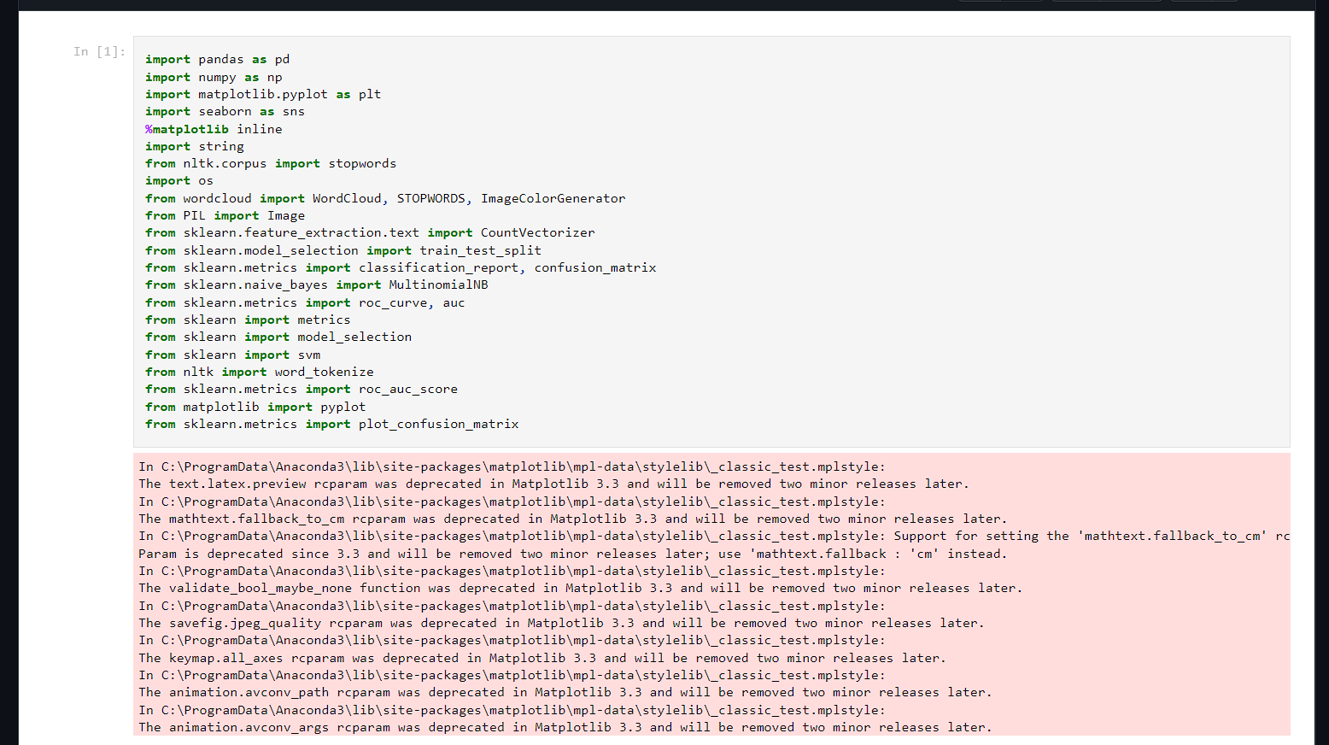
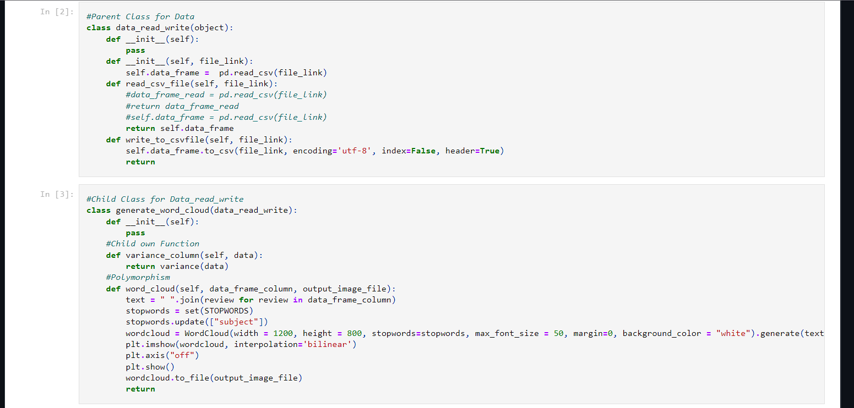
IMPLEMENTATION

Slide 6
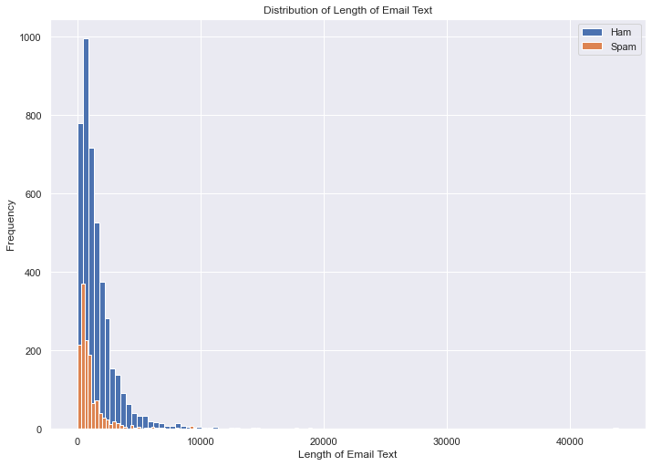
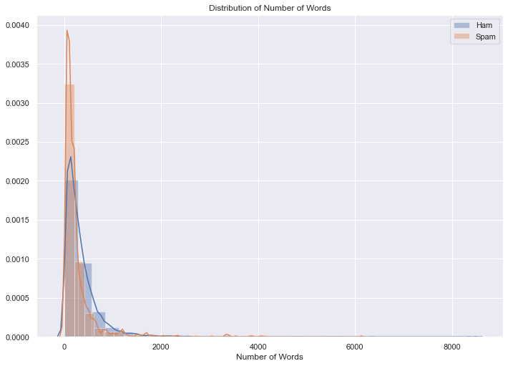
DIAGRAM

Slide 7
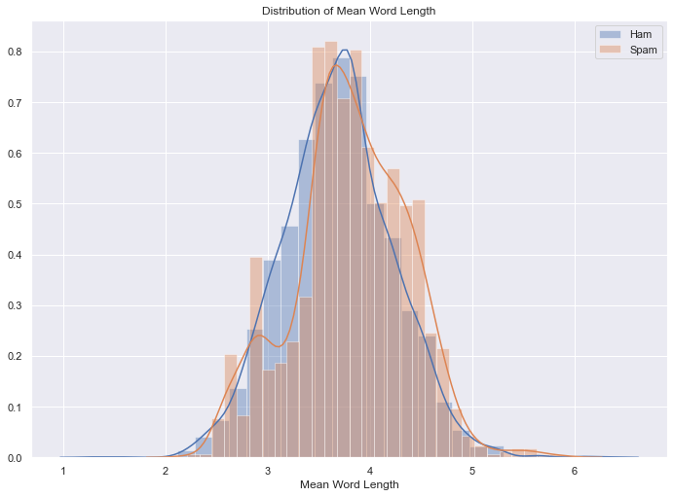

Slide 8
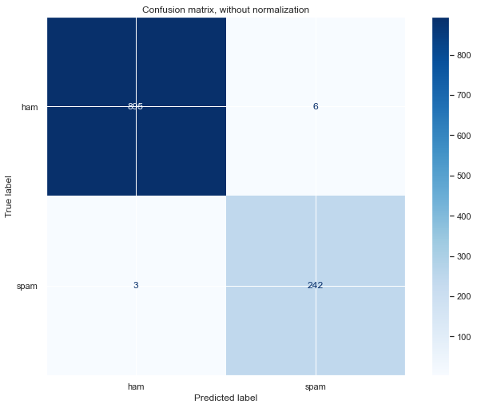
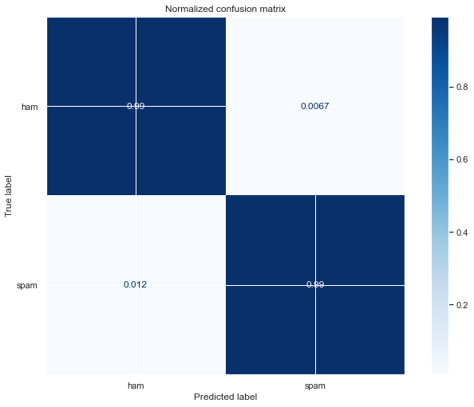

Slide 9
SUMMARY
So this is how you can train a machine learning model for the task of detecting whether an email or a message is spam or not. A Spam detector detects spam messages or emails by understanding text content so that you can only receive notifications about messages or emails that are very important to you. I hope you liked this article on the task of detecting spam alerts with machine learning using Python. Feel free to ask your valuable questions in the comments section below.

